Slide 1
IT1762
Data Structures & Algorithms
Topic 2B
FOR loops

Slide 2
Topics
Refresher on FOR loop
Objectives:
Identify repetitive tasks
Be able to use FOR loop constructs for repetitive tasks
Use counter in FOR loop

Slide 3
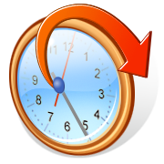
Need for Repetition
In computer programs, as in our every life, we encounter repetitive tasks.
For example, we wake up, freshen ourselves, take break fast, go to school and back home… and
.. It repeats the next day.
It is the same for computer programs.
Let us take a look at a simple example.

Slide 4

Example1 of repetitive problem
  Problem : Display a title in a message box for 50 times
  Example of C# codes:
  string myMessage;
  myMessage = “Hello My friend! ”;
  MesageBox.Show (myMessage);
  MesageBox.Show (myMessage);
  MesageBox.Show (myMessage);
  … // repeat the above statement 50 times
  This is not the way to code it.
  FOR loop will help us to code this better!

Slide 5
Using FOR LOOP Statement
FOR
The for statement has the following syntax:
for ( initialise; condition; increment)
{
statement1
statement2 ....
}
where:
for : compulsory keyword.
Initialise : start value of loop counter.
Condition : condition to test whether to loop.
increment : value to increase loop counter.

Slide 6
Using for Statement
How to display message box 50 times?
Rewrite the code as follows:
FOR
Initial condition
Increment after execution of each loop
  string myMessage;
  myMessage = “Hello My friend! ”;
for ( int i = 1; i <= 50; i++)
{
  MesageBox.Show (myMessage);
} //end of FOR loop
  MesageBox.Show (“Exit Loop”);//
Condition to test whether to loop
Initial conditions i = 1
i i<=50? Run repeated statements
1 True MessageBox.Show(mymessage)
2 True MessageBox.Show(mymessage)
…
50 True MessageBox.Show(mymessage)
51 False MessageBox.Show(“Exit loop”)

Slide 7
Example2 of repetitive problem
  Problem : Add the numbers 1,2,3,4,5. Display the sum
  In this case, the task to be accomplished repeatedly is the addition operation:
  Evidently, the above approach is not desired. What if we need to add 1 to 500? We can accomplish this task more efficiently using a for statement.
  int sum = 0;
  sum = sum + 1;
  sum = sum + 2;
  sum = sum + 3;
  sum = sum + 4;
  sum = sum + 5;
  lblDisplay.Text = sum.ToString();

Slide 8
Using For Statement
FOR
The for statement has the following syntax:
for ( initialise; condition; increment)
{
statement1
statement2 ....
}
where:
for : compulsory keyword.
Intialise : start value of loop counter.
Condition : condition to test whether to loop.
increment : value to increase loop counter.

Slide 9
Using For Statement
FOR
Returning to the problem of adding 1,2,3,4,5, we can rewrite the code as follows:
Initial condition
Increment after execution of each loop
int sum = 0;
for ( int i = 1; i <= 5; i = i +1 )
{
sum = sum +i;
}
lblDisplay.Text = sum.ToString()
Condition to test whether to loop
Initial conditions i = 1
I i<=5? sum
1 True 1
2 True 3
3 True 6
4 True 10
5 True 15
6 False

Slide 10
Exercise 1:
What is the output of the following code?
string text;
for (int i=0; i<=4; i++)
{
text = “i is:” + i + “\n”;
display.AppendText (text);
}
i is 0
i is 1
i is 2
i is 3
i is 4

Slide 11
Exercise 2:
What is the output of the following code?
string text;
for (int i=5; i<=10; i++)
{
text = “i is:” + i + “\n”;
rtbDisplay.AppendText (text);
}
The output in rtbDisplay is:

Slide 12
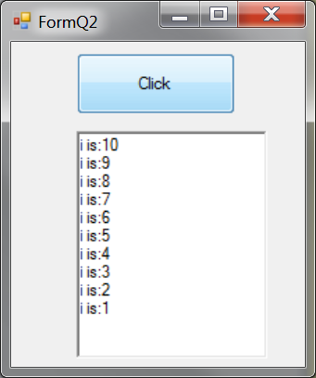
Exercise 3:
Fill in the blanks to display number from 10 to 1 in descending order
string text;
for ( ; i ; )
{
text = “i is:” + i + “\n”;
rtbDisplay.AppendText (text);
}
The output in rtbDisplay is:

Slide 13
Exercise 4:
Spot the 10 mistakes in the following code and rewrite it.
string text;
for ( i=1.0 , i>=10.0 , i);
text = “i is:” + i + “\n”;
display.AppendText (text);
string text;
for ( int i=1 ; i<=10; i++)
{
text = “i is:” + i + “\n”;
display.AppendText (text);
}

Slide 14
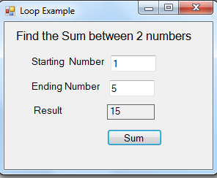
Example 1:
Find the sum between 2 numbers
Let us generalize the problem. Instead of adding numbers 1 through 5, we allow the user to enter a starting and ending number. The computer then computes the sum between these 2 numbers

Slide 15
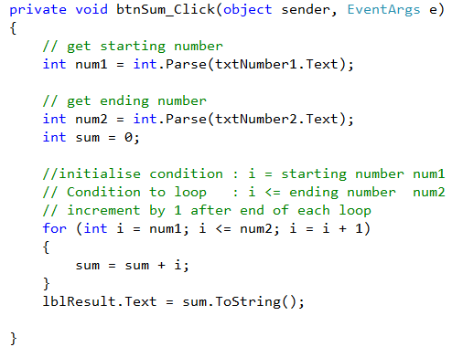
Example 1: Find the sum between 2 numbers
Codes:

Slide 16
Summary
  Define loop
  How to use FOR loop
  When to use FOR loop
  Common mistakes of FOR Loop

Slide 17
Practical 2B
1. Using FOR loop
Spot the mistakes and rewrite the code
int i;
for (int i=1; i > 10 ; i) ;
{
MessageBox.Show( i + “ I feel great today! ”);
// Display this line for 10 times
}

Slide 18
Practical 2B
2. Using FOR loop
Spot the mistakes and rewrite the code
for (float i=1.0, i < 5.0 , i+1.0) ;
{
MessageBox.Show( i + “ I feel great today! ”);
// Display this line for 5 times
}

Slide 19
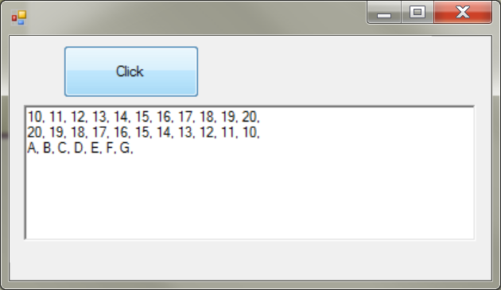
Practical 2B
Create a window application to perform the following tasks when user clicks “Click Me” button:
  It prints out numbers from 10 to 20 in ascending order
  It prints out numbers from 20 to 10 in descending order
  It prints out Alphabets from A to G
The output is display in rtbDisplay rich text box
You MUST use FOR loops to perform the above tasks

Slide 20
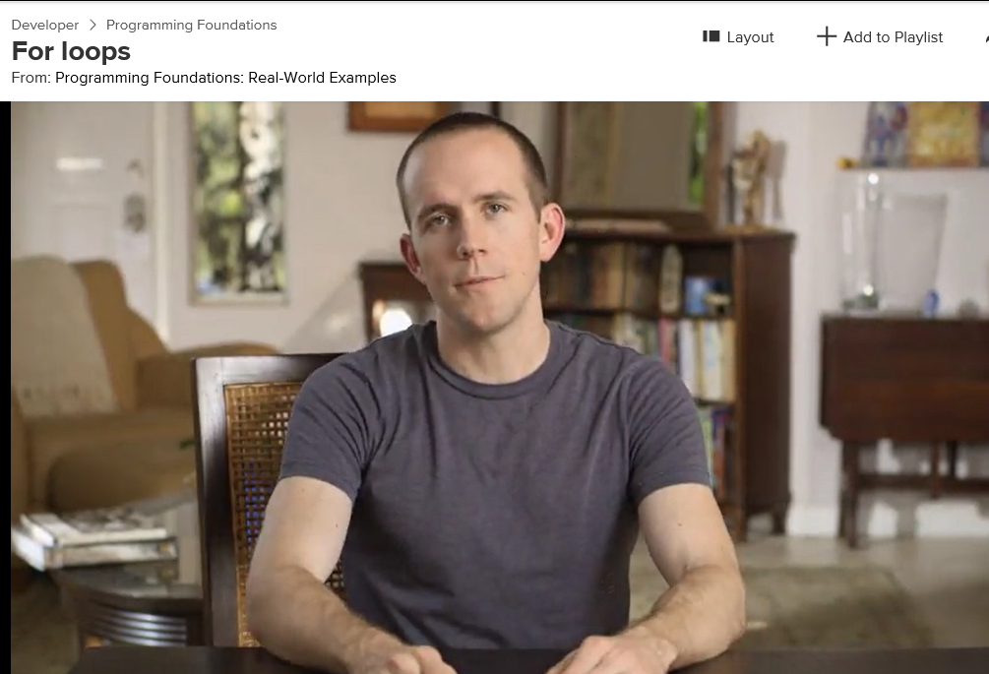
Extras elearning:
Differential Learning
Visit Lynda.com site
Watch Course: Programming Foundations: Real-World Examples
Topic: 10.1 For Loops (5Min)
Topic: 10:2 While Loops (3Min)
  It gives excellent explanation with day to day examples on how to apply Loops.

Slide 21
IT1762
Data Structures & Algorithms
End of Topic 2B
1 Dimensional Arrays

